Slide 1
Traffic Flow Modelling
Project in Applied Mathematics
By
Vilmer Dahlberg (F)

Slide 2
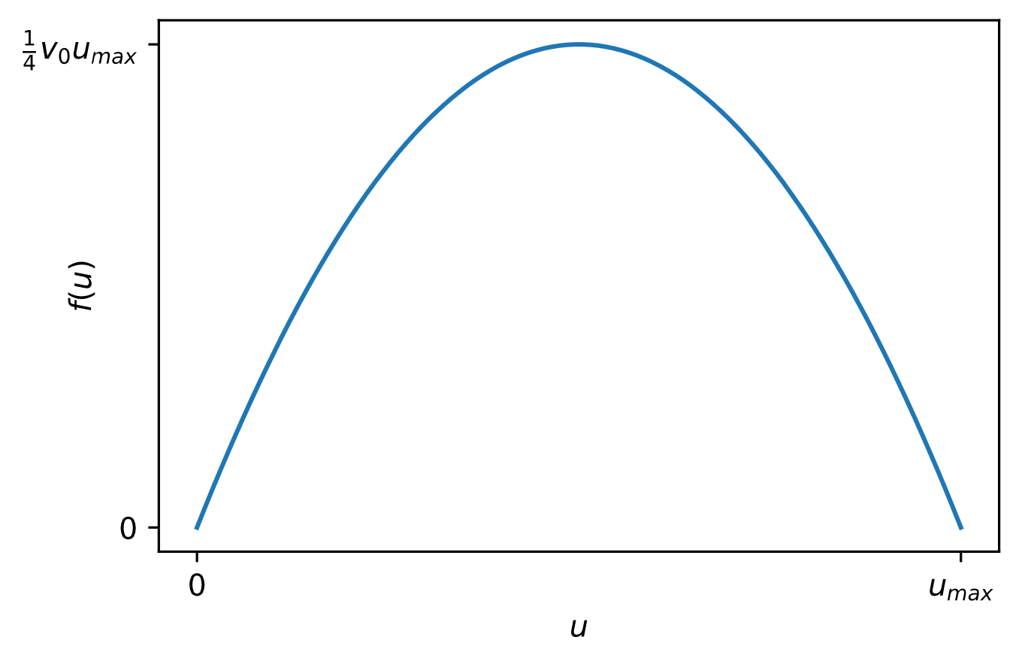
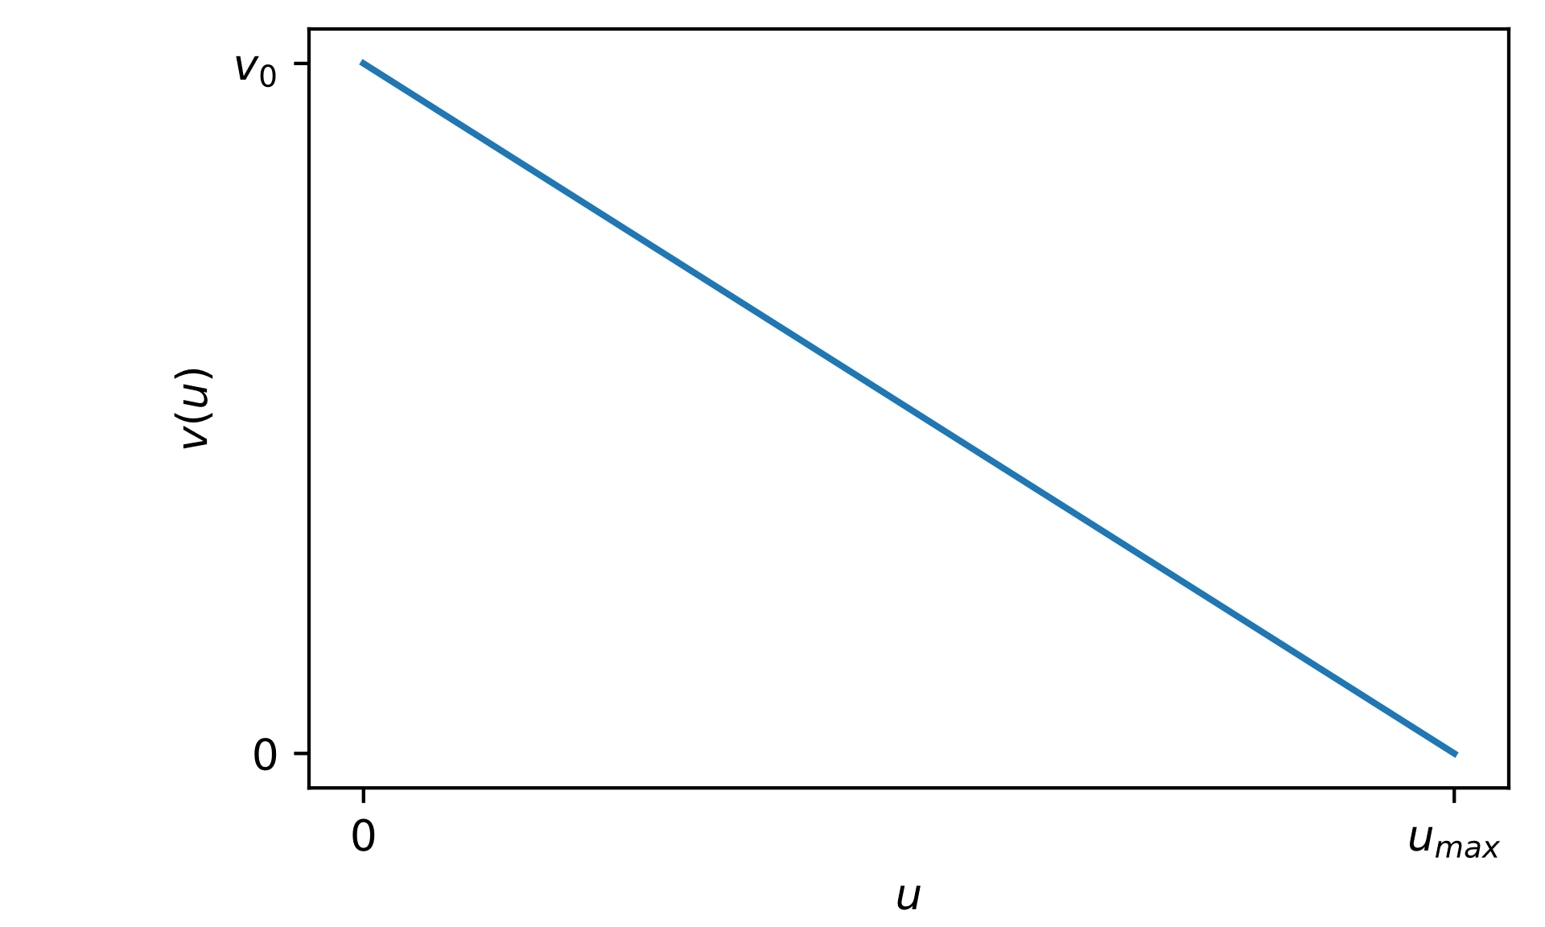


Introducing the Problem
Concentration
$0≤u\left(x, t\right)≤u_{max}$
0≤𝑢(𝑥, 𝑡)≤𝑢_max
Velocity
$$v\left(x, t\right)=v_{0} \left(1 −\frac{u}{u_{max}}\right)$$
𝑣(𝑥, 𝑡)=𝑣_0 (1 −𝑢/𝑢_max )
Flux
$$f\left(u\right)=v(u)u$$
𝑓(𝑢)=𝑣(𝑢)𝑢
Conservation Law
$$u´_{t}+f´u´_{x}=0$$
$$u´_{t}+{f´}_{x}=0$$

Slide 3
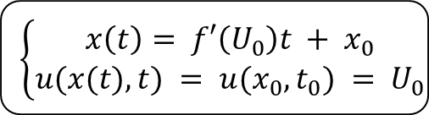
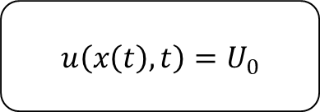
Characteristic lines
$$u\left(x\left(t\right), t\right)=U_{0}$$
$$\left\{\begin{aligned}x\left(t\right)= f′\left(U_{0}\right)t + x_{0} \\ u(x(t), t) = u(x_{0}, t_{0}) = U_{0}\end{aligned}\right.$$

Slide 4
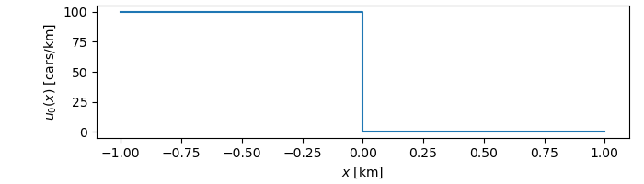
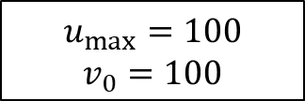
Characteristic lines
$$u_{max}=100$$
$$v_{0}=100$$

Slide 5
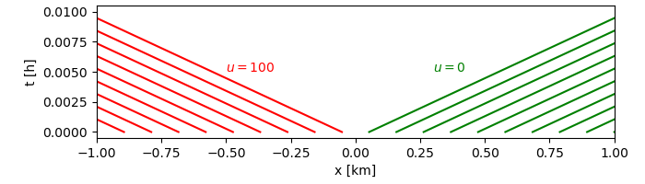
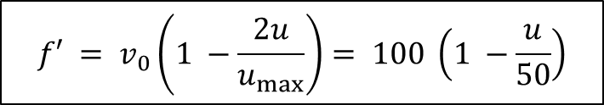
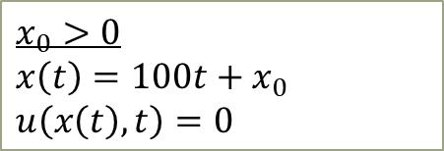
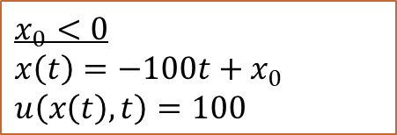
Characteristic lines
$$f′ = v_{0}\left(1 −\frac{2u}{u_{max}}\right)= 100 \left(1 −\frac{u}{50}\right)$$
$$x_{0}<0$$
$$x\left(t\right)=−100t+x_{0}$$
$$u\left(x\left(t\right), t\right)=100$$
$$x_{0}>0$$
$$x\left(t\right)=100t+x_{0}$$
$$u\left(x\left(t\right), t\right)=0$$

Slide 6
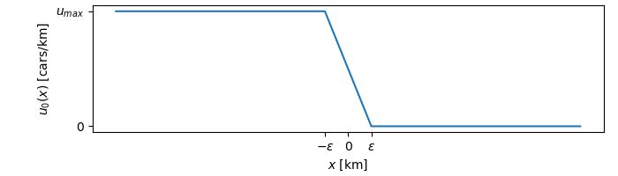
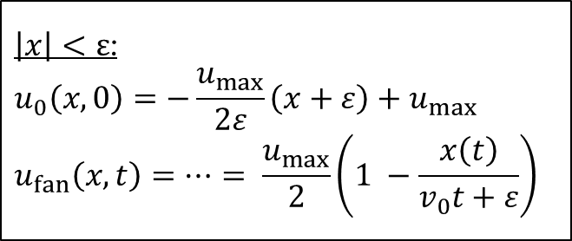
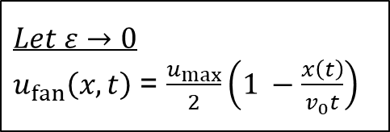
Characteristic lines
$\left|x\right|<ε$:
$$u_{0}\left(x, 0\right)=−\frac{u_{max}}{2ε}\left(x+ε\right)+u_{max}$$
$$u_{fan}\left(x, t\right)=…= \frac{u_{max}}{2}\left(1 −\frac{x\left(t\right)}{v_{0}t+ε}\right)$$
$$Let ε→0$$
$u_{fan}\left(x, t\right)$ = $\frac{u_{max}}{2}\left(1 −\frac{x\left(t\right)}{v_{0}t}\right)$

Slide 7
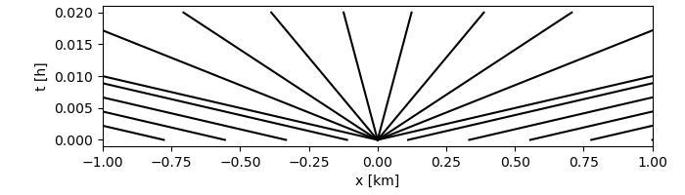
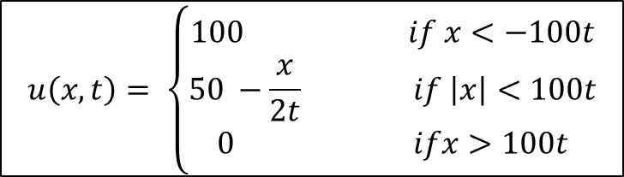
Characteristic lines
$$u\left(x, t\right)= \left\{\begin{aligned}100 if x<−100t \\ 50 −\frac{x}{2t} if \left|x\right|<100t \\ 0 ifx>100t\end{aligned}\right.$$

Slide 8
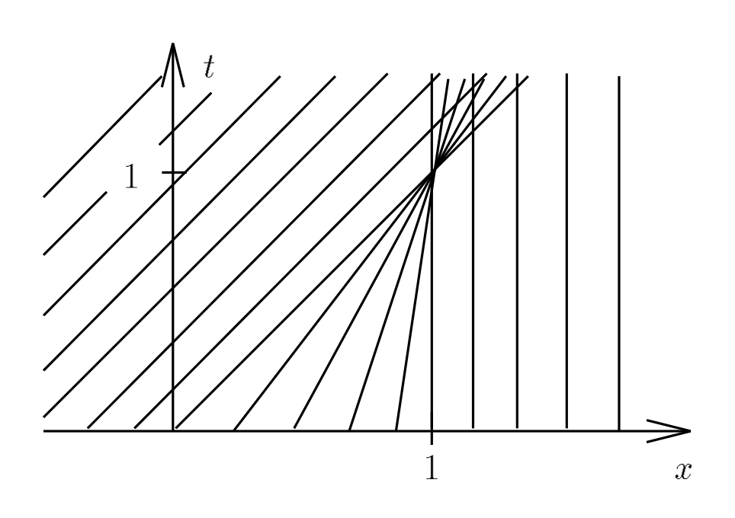
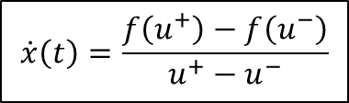


Jump condition
$$u^{−}$$
$$u^{+}$$
$$\dot{x}\left(t\right)=\frac{f\left(u^{+}\right)−f\left(u^{−}\right)}{u^{+}−u^{−}}$$

Slide 9
Problem 1: Path of cars
Problem 2: Shock waves

Slide 10
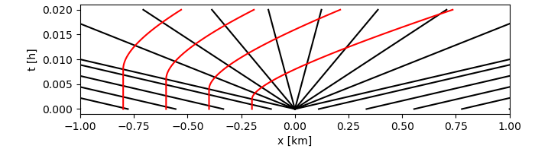
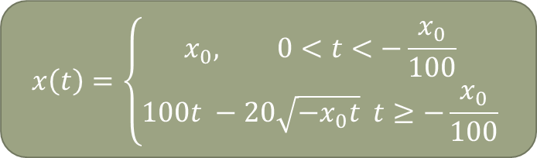
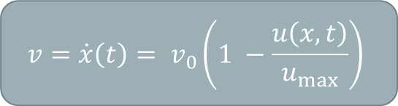
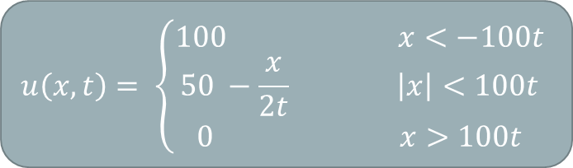

Problem 1: Path of cars
$$u\left(x, t\right)= \left\{\begin{aligned}100 x<−100t \\ 50 −\frac{x}{2t} \left|x\right|<100t \\ 0 x>100t\end{aligned}\right.$$
$$\int{dt}$$
$$x\left(t\right)=\left\{\begin{aligned}x_{0}, 0<t<−\frac{x_{0}}{100} \\ &100t −20\sqrt{−x_{0}t} t≥−\frac{x_{0}}{100}\end{aligned}\right.$$
$$v=\dot{x}\left(t\right)= v_{0}\left(1 −\frac{u\left(x, t\right)}{u_{max}}\right)$$

Slide 11
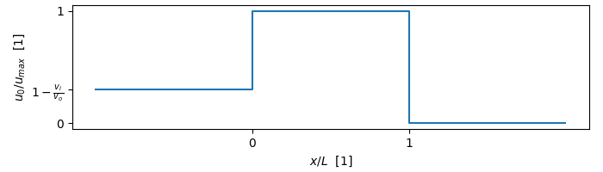
Problem 2: shock waves
$$u_{max}=100$$
$$v_{0}=100$$

Slide 12
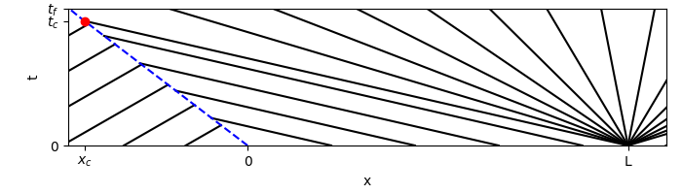
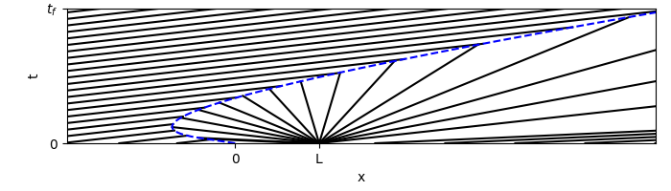


Problem 2: shock waves
$$\frac{L}{v_{i}}$$
$$\frac{L}{v_{0}}$$

Slide 13
Conservation law
Characteristic Lines
Jump condition
Problem 1
Concentration
Path of cars
Problem 2
Concentration
Longest wait time
Time until traffic flows freely

